Slide 1

Welcome to the Holy Cross Sixth Form!

Slide 2
Sixth Form Team
Mr Oliver : Head of Sixth Form
Ms Gordon : Deputy Head / Careers Lead
Mrs Chen : Head of Year

Slide 3
Welcome to the Holy Cross Sixth Form!

Slide 4


Slide 5

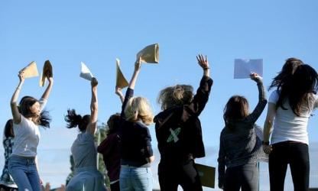



Slide 6

A-Levels are a bigger academic challenge than a degree

Slide 7
“I found it hard to adapt to a different way of working at A-Level”

Slide 8
“I did well in my GCSEs and didn’t have to work that hard”

Slide 9
“It took me two months to really get going…”

Slide 10
“I should never have done that subject …”

Slide 11
“I was used to getting A’s and B’s for my work but now I was getting C’s and D’s”

Slide 12
“I got a job – I started off doing 2 shifts but then it became 3 or 4 before Christmas”

Slide 13
“There were suddenly more distractions outside of school”

Slide 14
“I wish I’d looked into unis and courses earlier”

Slide 15

Starting well as a student…
Settle and commit to Subjects
Organise your notes
Work hard in lessons
Work hard outside of school and time mgt
Independent Study
Use of the Study Area
Take Opportunities

Slide 16


Slide 17


University
Apprenticeship
Work
2 year journey

Slide 18
2 year journey
Academic success
Physical and Emotional wellbeing
Personal growth
Spiritual development
Notes:
pupils' ability to be reflective about their own beliefs - religious or otherwise - that inform their perspective of life and respect for other people's faiths, feelings and values.

Slide 19
Year 12 Team - Tutors
12 Charity - Mr Higham
12 Faith - Ms Espie
12 Hope - Ms Facey and Ms Simeonova
12 Mercy - Mrs Gowan
12 Peace - Mr Terracciani and Dr Choudray

Slide 20

Tutors are mentors to the students
Your first point of contact with the school
Mentor meetings 2 days per week after Christmas

Slide 21
The Year 12 team is committed to create an inclusive and inspirational learning environment for our students. We are dedicated to high standards of pastoral care, and the physical and emotional wellbeing of our students is at the centre of our provision. We encourage students to engage with enrichment opportunities to support their personal development and grow into responsible and mature individuals. We have high academic standards and we support students to achieve their full potential. We guide students to make informed decisions about their future. Once students leave Holy Cross, we want them to be confident young adults, ready to share their skills and talents with the community and make a positive impact.

Slide 22

Academic team/Teachers

Slide 23
3 Subjects
(2 or 4 for selected students)
1 subject
5 teaching hours
at least 5 hours study

Slide 24

We closely monitor attendance
Attendance during a school year | Equals Days Absent | Which is approximately weeks absent | Approximately this number of hours of lost learning
95% attendance | 9 days | 2 weeks | 50 hours
90% attendance | 19 days | 4 weeks | 100 hours
85% attendance | 29 days | 6 weeks | 200 hours
The higher a pupil’s attendance, the more they are likely to learn, and the better they are likely to perform in exams.

Slide 25

Attendance
Parents call 6th Form Admin Team by 8.30am : 0208 714 5050
sixthformadmin@holycross.kingston.sch.uk
All appointments outside of school day: Fri pm

Slide 26
Monday | Tuesday | Wednesday | Thursday | Friday
In tutor rooms at 8.35 Registration: 8:40-9:00
Period 1-2: 9 -10:50 (HX) 9 - 10:30 (RC)
Period 3-4: 11:25 - 13:10 (HX) 11:25 - 13:05 (RC) |  |  |  | 11:25-12:25 (HX) 11:25 - 13:05 (RC)
Period 5: 14:15 - 15:25 (HX) 13:45 - 15:25 (RC)
Christianity and other faiths.
Discussion based - no homework.
Spiritual development
PSHE
GEN RE
medical appointments
P5 Study at home (optional)
Enrichment activities
Only if ATL is expected
Off school
Detentions: 15 minutes same day, 1 hour long with one day notice
Notes:
pupils' ability to be reflective about their own beliefs - religious or otherwise - that inform their perspective of life and respect for other people's faiths, feelings and values.

Slide 27
Personal, Social, Health and Economic Education (PSHE)
The only time all Year 12 students are in school together (assemblies). Topics that we will cover during the next two years:
Apprenticeships and degrees
Career paths
UCAS applications and personal statements
Work experience
Presentation skills and public speaking
Self-defence course
Financial education, student finances and university loans
Keeping safe in relationships
Decision making
Taking care of ourselves, mentally and physically
Police visits

Slide 28

Wednesday Period 5
Enrichment Activities
termly rotation
Gym
PE
Young Enterprise
Music band
Faith in Action leadership
Primary school reading

Slide 29

Breaks - lunch time - Friday PM - P5 study

Slide 30

Leadership Opportunities
Eco reps
Helping Multilingual students
Open Evenings
Fundraising
Year 5 and 6 Taster days
Head Girl Team
Head of House
Young Enterprise
Big Sister scheme
House competitions
Mental Health Ambassadors
Run a club
Subject prefects
Social Cahtolic Teaching leadership
Student council
Notes:
30

Slide 31


Slide 32
Extended Project Qualification (EPQ)
It’s a stand alone qualification worth half an A Level!
Completed by the end of year 12
It’s up to 28 UCAS points (depending on your grade)
Some universities will lower the entry requirements if you have a good EPQ.
It can be:
a) a 6,000 word dissertation or
b) an artefact plus a 3,000 word report
All students achieved A-A* last year.

Slide 33
Academic success:
Progress Tracking & Intervention
Study skills workshop September 2024
Data Drops or parents evening Every Half Term
Parents Evening: Thursday 22nd January 2026 at Richard Challoner
Tutor reviews after each report/Subject intervention
End of Year Exams from Wednesday 10th June
Review of mock results
September 2024 retakes for students with U and E in the mocks & discussion with students about next steps
UCAS predicted grades
Y13 Mocks in February (next academic year)
Extra revision sessions closer to the A Level Exams

Slide 34

Physical and Emotional Wellbeing
School Health practitioner
Mental Health First Aiders (trained teachers)
Extra curricular activities (PE, gym, music band)
Well-being sessions during registration
PSHE sessions on Anxiety and stress, mental health, first aid
Girls On Board

Slide 35

Spiritual development
Daily prayer
Weekly general RE lessons
Diversity days
Faith in action day
Weekly diversity activities during registration
Chapel is open for prayers for all our students, regardless of religious beliefs.
Muslim students can use the chapel during the month of Ramadan
Volunteering opportunities in local
community
Notes:
pupils' ability to be reflective about their own beliefs - religious or otherwise - that inform their perspective of life and respect for other people's faiths, feelings and values.

Slide 36
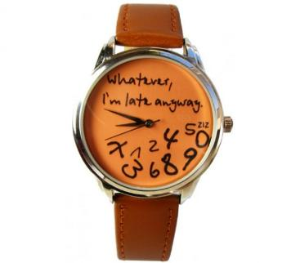
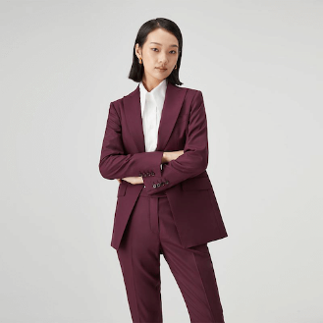
Punctuality
Dress code
8.35am in school
After school detentions
Change clothes
After school detentions

Slide 37



Emails (sixth form admin team)
and google classroom
parent/guardian
summary

Slide 38


Slide 39

Careers Education, Information, Advice & Guidance (CEIAG)

Slide 40
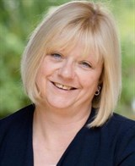
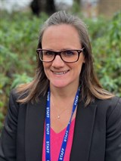
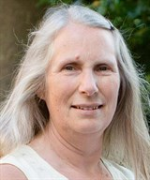
The CEIAG Team
Ms Lynn Gordon
Careers Lead & Deputy Head
Mrs Clare Dewar
Careers Advisor
Mrs Zoe Peters
Work Experience Coordinator

Slide 41


All Unifrog Tools
Access up to date quality information on career paths & Labour Market Information (LMI). Support your child to search for opportunities at colleges and Universities or link to employers and find out about apprenticeships.
Quizzes
Exploring pathways
Recording what you’ve done
Searching for opportunities
Drafting applications
Making applications
Interests profile
Careers library
Activities
UK universities
UK Personal Statement
Post 18 Intentions
Personality profile
Subjects library
Skills
US universities
Classes
Locker
Work environments profile
Know-how library
Interactions
European universities
Subject References
Applications list
MOOC
Oxbridge
CV / Resumé
Skills profile
Webinars
Canadian universities
Writing tool
Read, Watch, Listen
Asian universities
Common App Essay
Australasian Unis
US recommenders
MidEast & Africa Unis
Notes for Reference writers
Irish Universities
Special Opportunities
Events

Slide 42
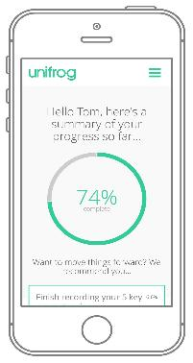
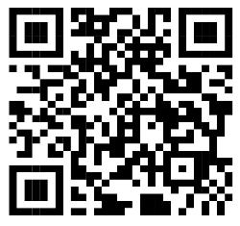
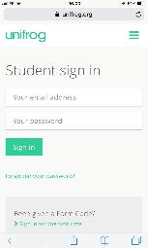

Parents & guardians -
get signed up
Scan this QR code or go to www.unifrog.org/student and click ‘Sign in for the first time’
You’ll be asked for some details and this ‘Sign up Code’:
THCSPARENTS
After signing up, log into Unifrog using your email address and password via the student sign-in page!

Slide 43

Mon 6th - Fri 10th
July 2026

Slide 44
End of Year exams in June
Predicted Grades

Slide 45
Timeline UCAS
Year 12
Understand the pathways open to you
Research into university & apprenticeship opportunities
Go out on University visits
UCAS Parents Information Evening
Register for UCAS
Attend Taster Sessions
Draft your Personal Statement
Year 13
Complete your Application Form
Finalise your Personal Statement
Look at your predicted grades & reference
Preparing for interviews
Completing Entrance Tests
Finance / Accommodation
Transition to Uni

Slide 46

Support with applications for
Oxbridge

Slide 47
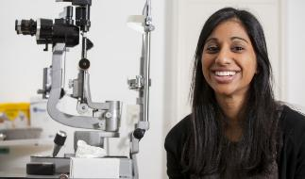
Support with applications for
Medicine

Slide 48

Resources for Parents
UCAS Website

